Slide 1
REAL TIME FACE ATTENDANCE SYSTEM
team members: Karthik sai Vazza(y00855359
Dedeepya kurra(y00356531)
GROUP 17

Slide 2
INTRODUCTION
Welcome to our presentation on a real-time face attendance system. With this system, teachers can easily track attendance and students can easily register their face. Our system is built using HAAR Cascade and Python T kinter for the graphical user interface.

Slide 3
The primary goal of this project is to create an automated student attendance system based on facial recognition. The test pictures and training images of this suggested technique are restricted to frontal and upright facial images that only contain a single face to improve performance. To ensure no quality variation, the test photographs and training images must be taken using the same equipment. To be identified, the pupils must also register in the database. The user-friendly interface allows for immediate enrollment.

Slide 4
PROBLEM STATEMENT
The traditional method of recording student attendance frequently has a number of issues. By doing away with traditional student attendance marking methods like calling out student names or verifying individual identity cards, the facial recognition student attendance system highlights its simplicity. Not only do they obstruct the teaching process, but they also divert students' attention at test times. During lecture sessions, an attendance list is distributed around the classroom in addition to calling names. It may be challenging to circulate the attendance sheet around a lecture class, particularly one with a big number of pupils.

Slide 5
The manual signing of students' presence, which is cumbersome and causes them to become distracted, is thus recommended to be replaced with a facial recognition student attendance system. Additionally, the automatic facial recognition-based student attendance system can overcome the issue of fraudulent approaches, and lecturers no longer need to count the number of students repeatedly to confirm their attendance.

Slide 6
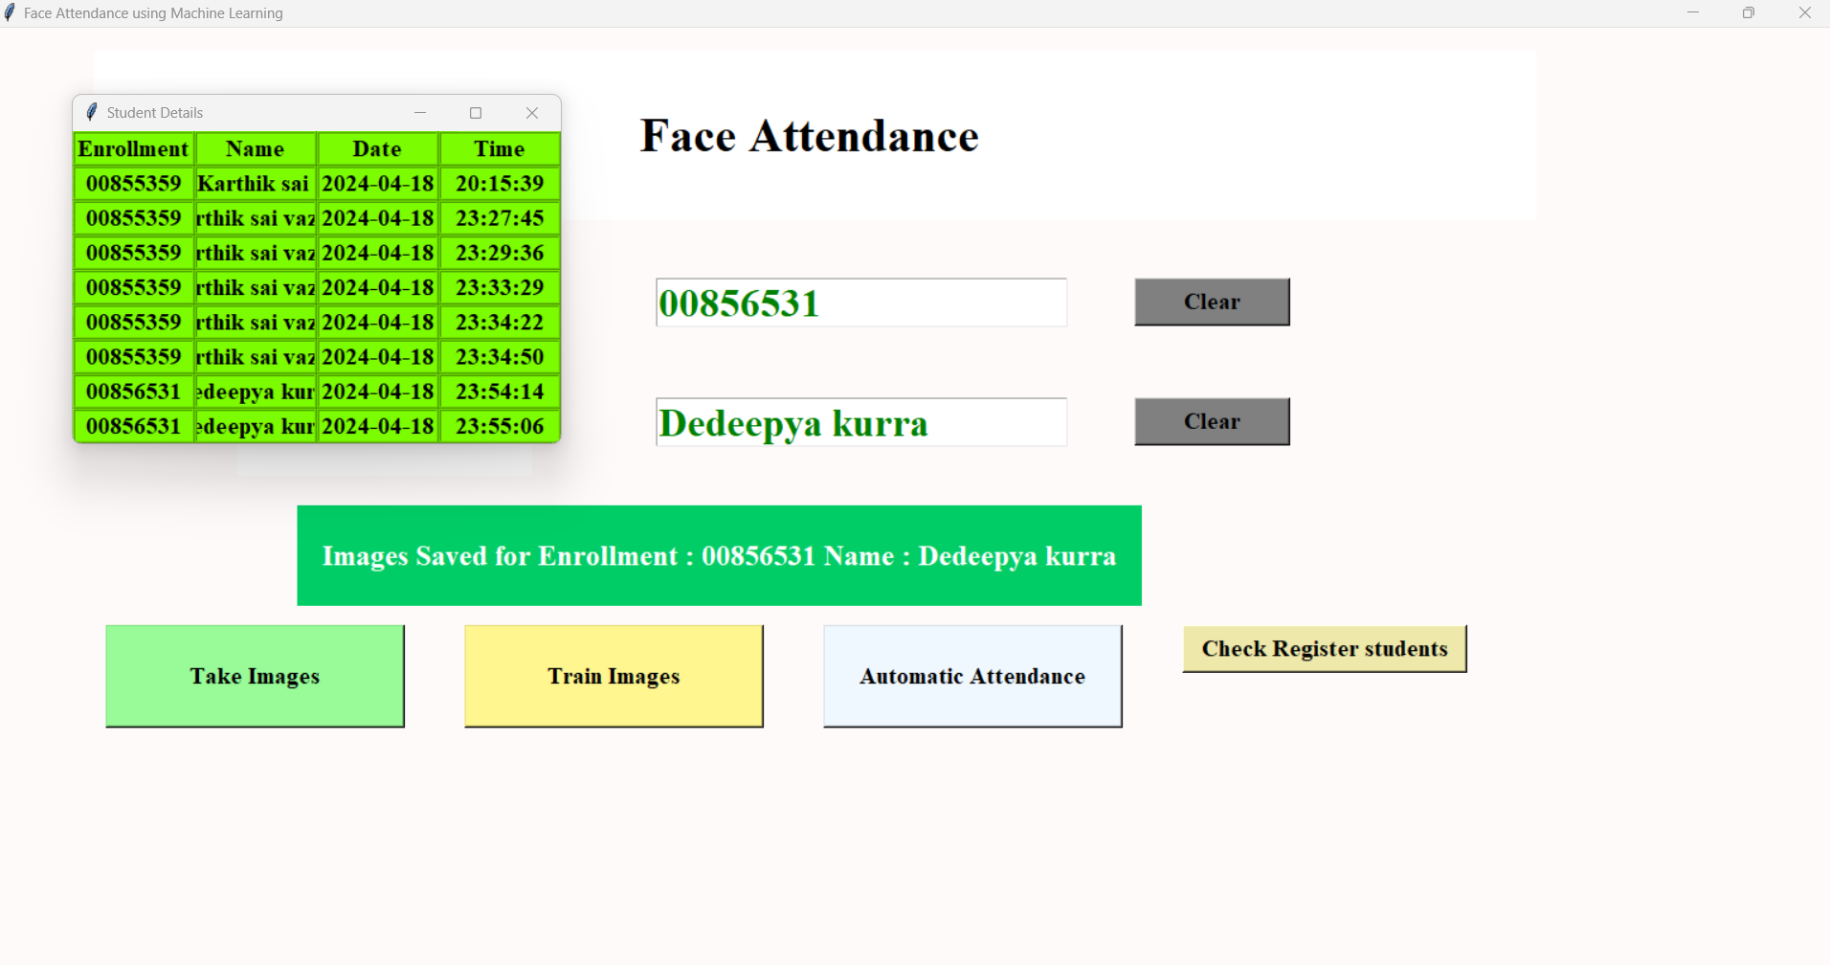

Slide 7
BACKGROUND
To recognize relatives, friends, or other people we are familiar with, face recognition is essential in daily life. We might not realize that several steps have been taken to recognize human faces. Our ability to acquire information and analyze it throughout the recognition process is a result of human intellect. The image that is transmitted to our eyes, and more particularly, the retina, provides us with information in the form of light. Electromagnetic waves take the shape of light, which is projected to human eyesight after being transmitted from a source onto an object.

Slide 8
In fact, it is a hard challenge to build an automated system to have the same capability as a human to recognize faces. However, we need large memory to recognize different faces, for example, in the Universities, there are a lot of students with different race and gender, it is impossible to remember every face of the individual without making mistakes. To overcome human limitations, computers with almost limitless memory, high processing speed and power are used in face recognition systems. The information that has been analyzed will be compared to other facial or object representations that we have in our memory to identify them. Creating an automated system that can detect faces with the same accuracy as a person is a difficult problem.

Slide 9
METHODOLOGY
The method uses a facial recognition-based attendance system for students. The technique starts with the picture capturing utilizing an easy-to-use interface, then moves on to pre-processing the facial photos that were collected, feature extraction from those images, subjective selection, and finally categorization of the facial images to be recognized. This suggested technique computes both LBP and PCA feature extraction algorithms, then compares their performance. With this method, LBP is improved to lessen the lighting impact. Moreover, a subjective selection method that combines improved LBP and PCA is created to improve accuracy. The next sections will go through the specifics of each level.

Slide 10
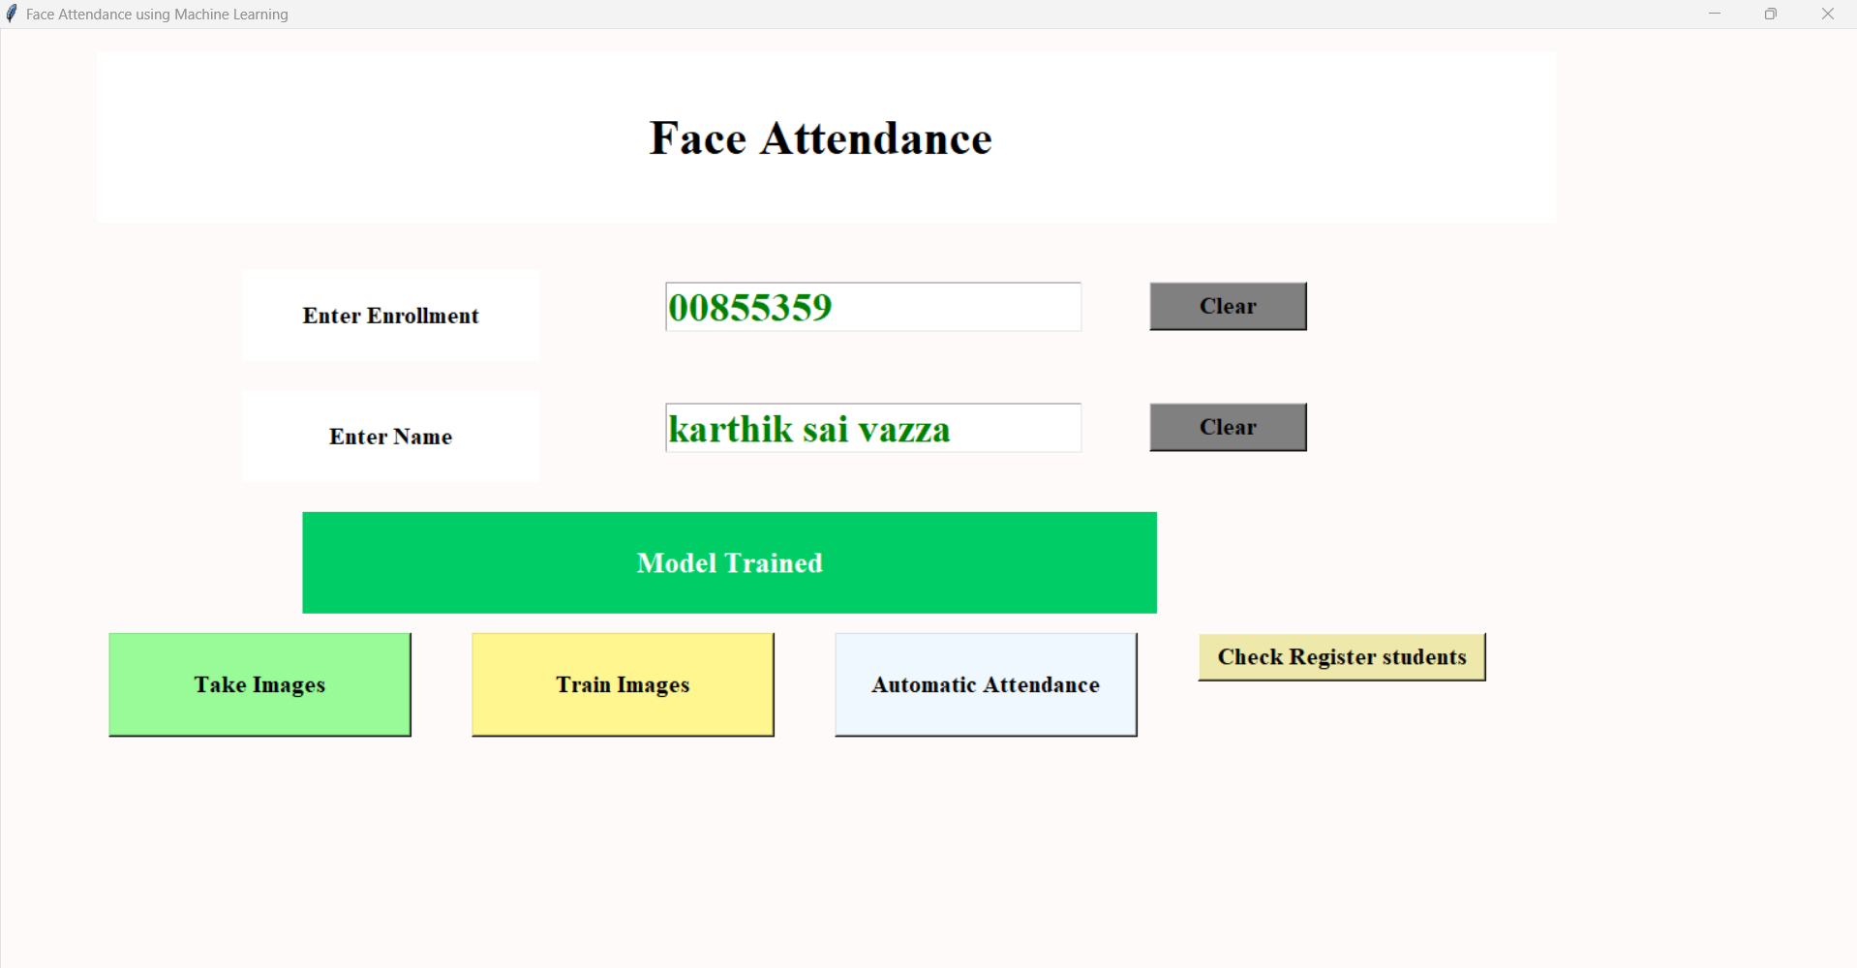

Slide 11
experiments
We did experiment in different ways like Trying to use same face number of times and trying to blink all the time or blinking continually or closing eye for a wile to find out bugs or to find out any bugs

Slide 12
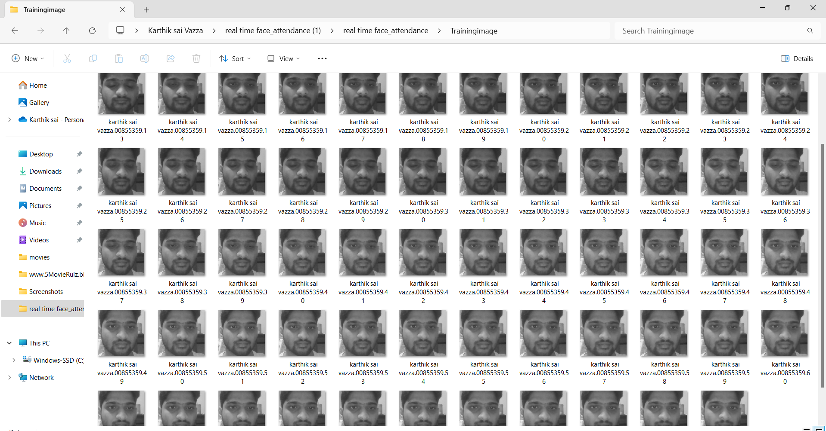
Trying to find any bugs or delays

Slide 13
And we tried how much length of the name and id it can read like how many charaters it can read while scanning and also check it works manually or not and is the data perfect or it is taking just the manually taken attendance or just the face scan attenadance . We also check is it Turing the camera automatically
If it cant read a face or cant find the face in the database.

Slide 14
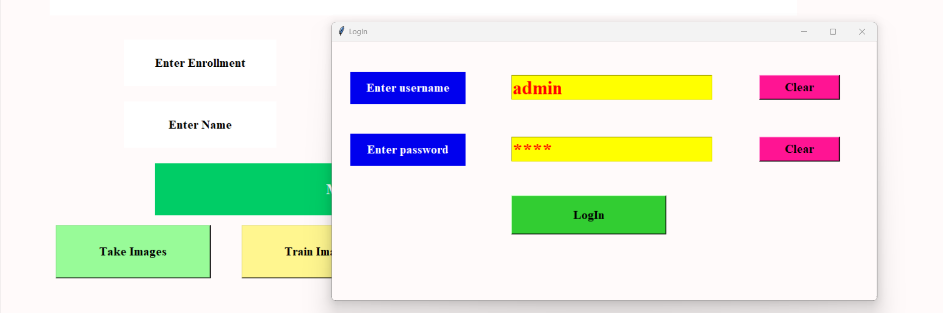
We also checked is the adim page is working properly or not is it giving the correct permissions or not when needed.

Slide 15
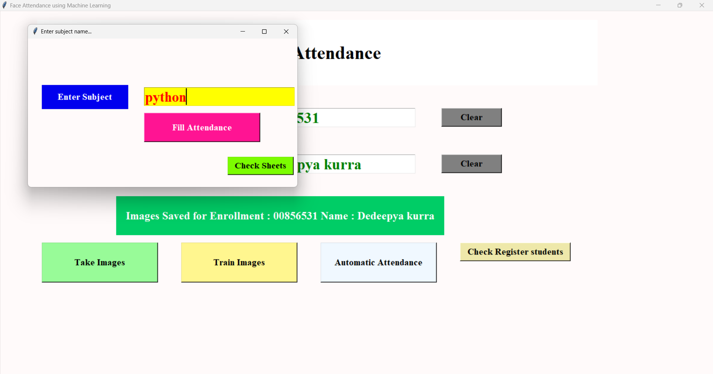
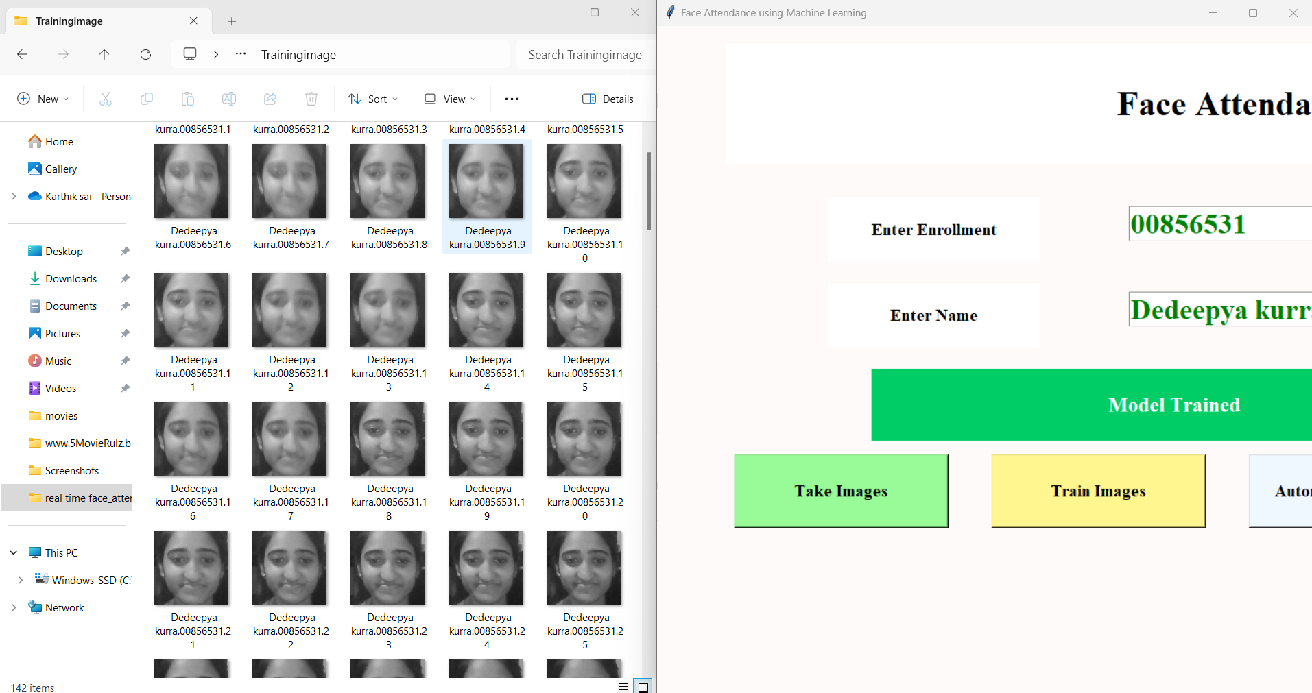
Seleting subject
Getting attendance

Slide 16
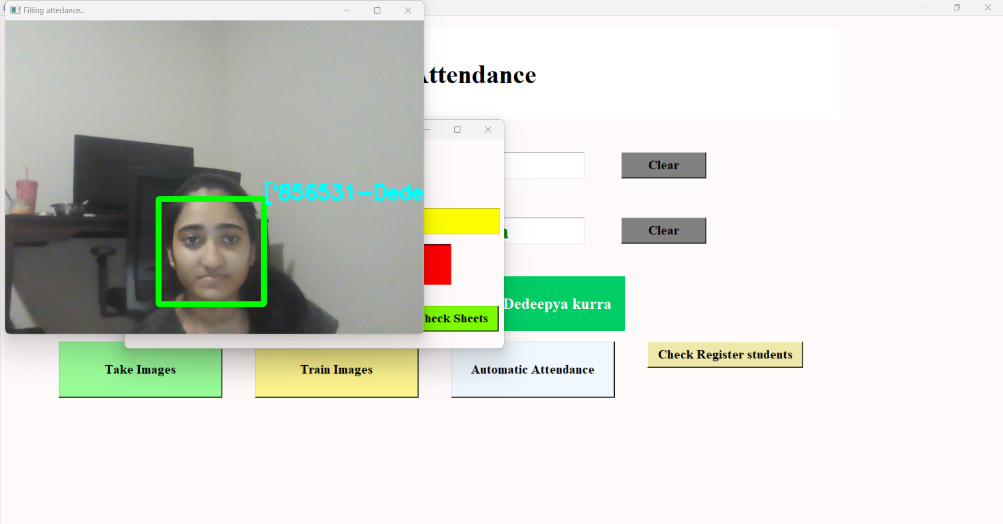
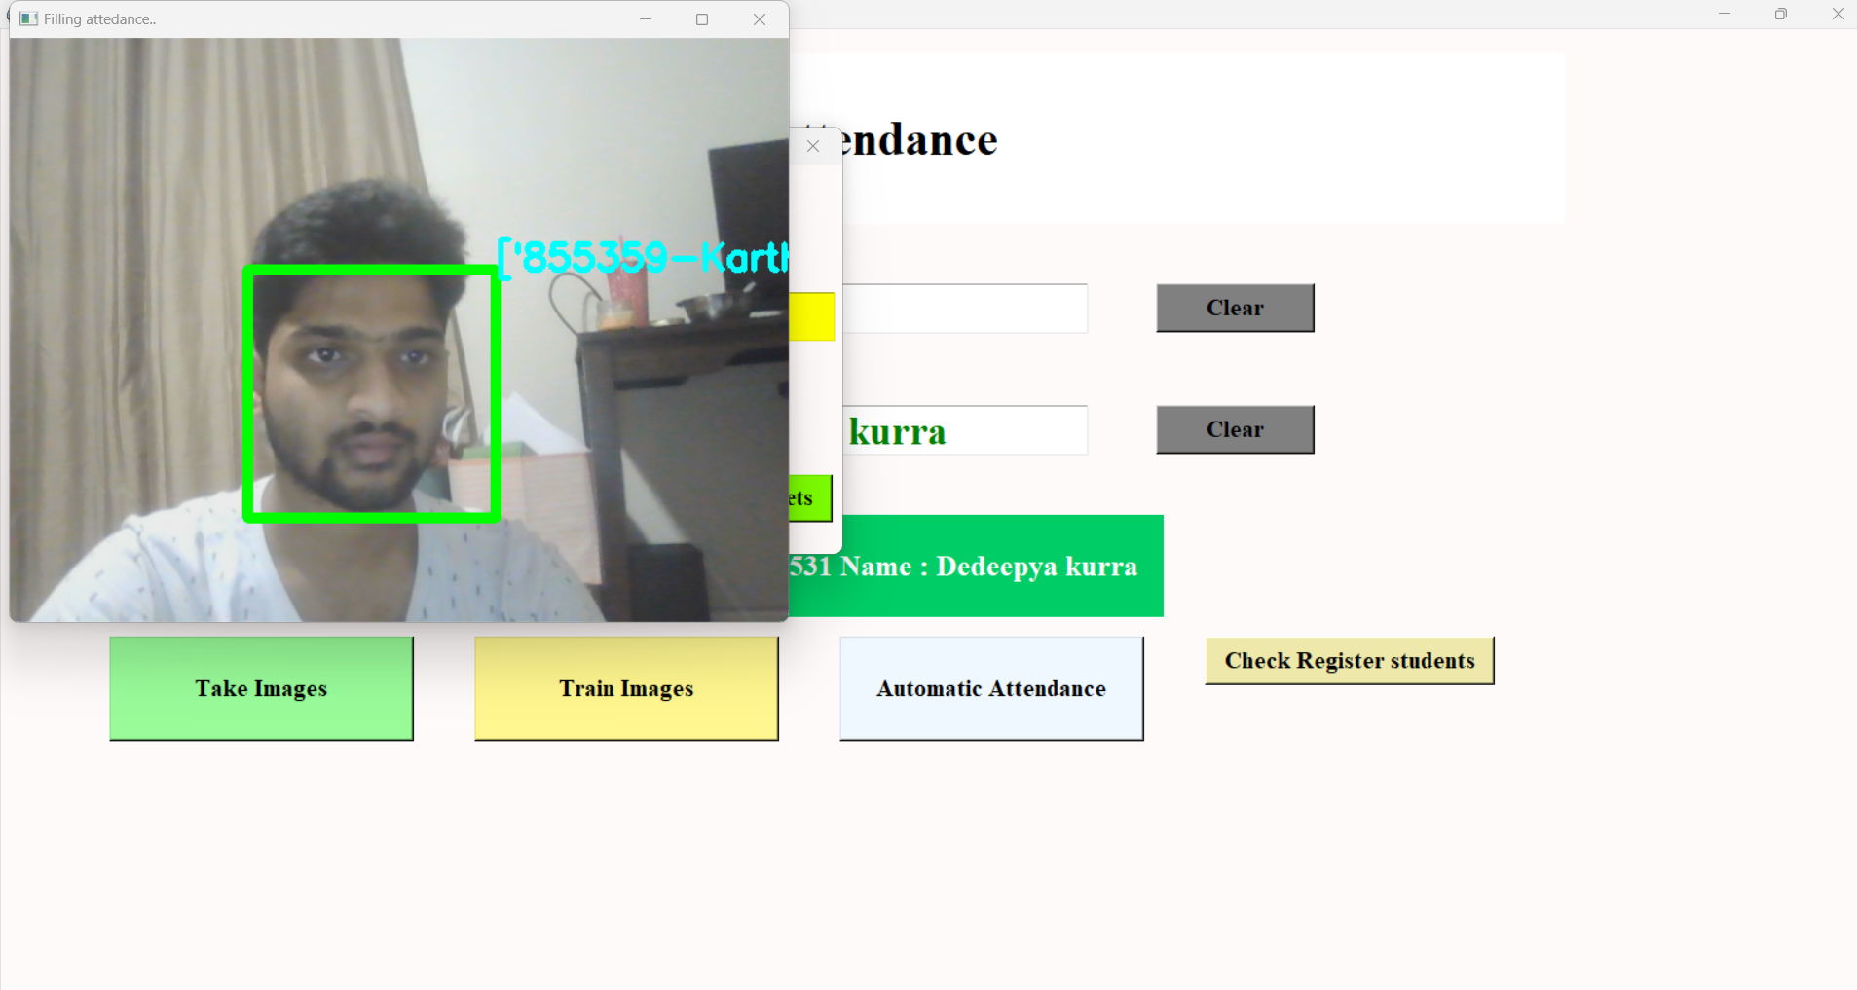

Slide 17
discussion
The student attendance system is based on texture-based aspects of facial photos, and this suggested methodology offers a mechanism to conduct face identification for that system. Facial recognition is the process of identifying a person by matching his or her live-captured image to previously taken pictures of that person in a database. Consequently, in addition to taking essential elements like lighting into consideration, the training set must be chosen depending on an individual's most recent appearance.

Slide 18
Using many datasets, the suggested technique is being trained and evaluated. One hundred and sixty-five photos of fifteen people with various diseases are included in the Yale face database. However, all of the photographs in this database are grayscale. As a result, we have created our own database of color photographs that is further divided into two sets: high quality and low quality. The quality of the images varies; some are blurry while others are more distinct.

Slide 19
Each data set's statistics were covered in the prior chapter. In this method, a facial picture or a video frame are used to recognize and locate the face using the Viola-Jones object detection framework. An algorithm is created from the observed face that can extract the key characteristics needed to do face recognition.

Slide 20
CONCLUSION
Real-time face attendance system is an innovative tool that can help schools, universities, and other educational institutions manage attendance efficiently. With its ease of use, accuracy, and flexibility, our system can save time and improve attendance tracking for both teachers and students.

Slide 21
Contribution of team members
Member 1(Karthik sai Vazza)
User interface development, code development, tester
Member 2 (Dedeepya kurra)
ML development, code development, tester

Slide 22
THANK YOU

